Slide 1

The Wellspring

Slide 2

"Come apart - before you come apart!"
— Mark 6:31
A project designed to refresh the mind and preserve the voice of the modern minister.

Slide 3

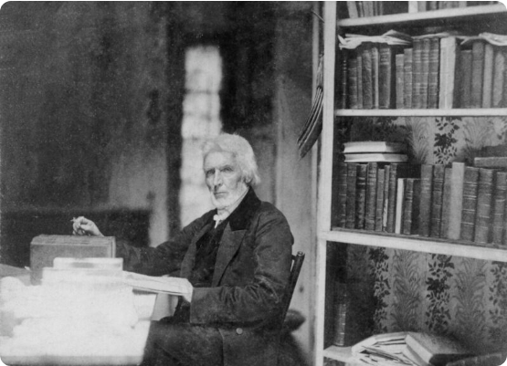
The Fragmentation Problem
Lost in the Noise
Pastors produce a lifetime of wisdom—thousands of pages of sermons, notes, and slides. Yet, much of it is:
Scattered across old hard drives
Buried in unsearchable Word docs
Locked away in "cloud" subscriptions
This fragmentation leads to burnout and the loss of a theological legacy.

Slide 4


The Solution: A Digital Sanctuary
A Sovereign "Second Brain"
The Wellspring is a unified, offline platform that gathers your work into one intelligent space. It acts as a permanent, searchable companion for your study.
It combines your past wisdom with historical giants to empower your future messages.

Slide 5






The Three Pillars of The Wellspring
Your Voice
The Library
The Word
A searchable database of every sermon, PowerPoint, and note you have ever written.
Historical commentaries from Matthew Henry, Spurgeon, Calvin, and Wesley.
The ASV Bible integrated with Strong's Concordance and TSK cross-references.

Slide 6
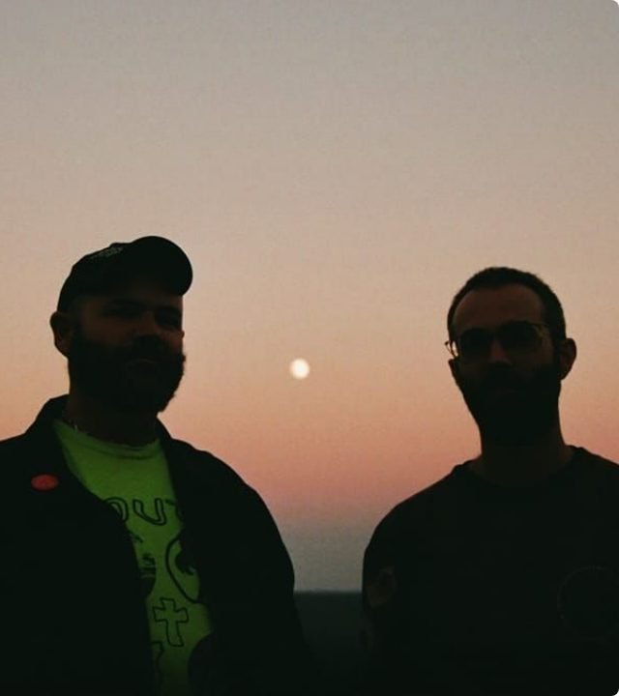
The Audio Brief
Listen to Your Study
Our offline system (ACE 1.5 + Whisper) generates private podcasts directly from your study notes.
Review your sermon outline or a summary of historical commentaries while you drive or walk—allowing for "passive reflection" and refreshment.

Slide 7

Administrative Stewardship
"What did we decide last year?"
Board meetings and budget sessions often involve promises and commitments. With The Wellspring, you have an Institutional Memory:
Instant Search: Find any meeting in 2 seconds.
Task Tracking: Recall exactly what you said you'd attend.
Decision Continuity: Connect budget goals to results.

Slide 8


A Sacred Trust: Secure Counseling
Total Privacy. Absolute Recall.
Pastoral counseling is a heavy responsibility. The Wellspring helps you honor that trust with continuity and care:
100% Offline: Notes never touch the cloud or servers.
Journey Context: Instantly recall where a family left off.
Sovereign Vault: You own the data; no subscriptions.

Slide 9
Sovereignty & Security
100%
No Data Egress. Zero Cloud.
Most AI tools sell your data or monitor your thoughts. The Wellspring is a fortress. Zero data ever leaves the device.
Absolute Intellectual Property Privacy
Works anywhere, even without internet
OFFLINE
No recurring subscription fees

Slide 10
The Wellspring vs. Cloud AI
Feature | Generic Cloud AI | The Wellspring
Privacy | Data stored on corporate servers | 100% Local (Zero Egress)
Theological Depth | Generic information | Historical Orthodox Library
Personal Context | Does not know your history | Pre-indexed Sermon Archive
Cost Structure | Monthly subscriptions | One-time infrastructure gift

Slide 11
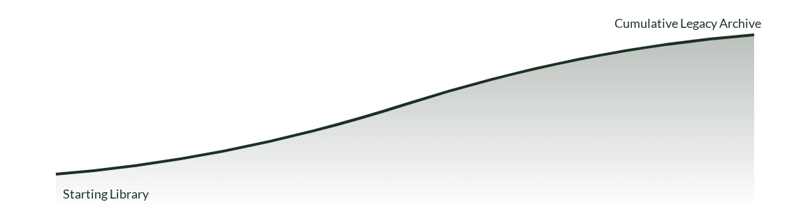
Building a Lifetime Archive
As you add every sermon and study, the "Wellspring" becomes an exponentially more valuable theological asset for the church.

Slide 12

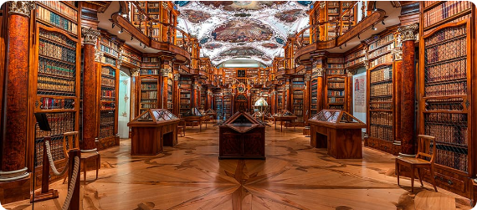

The Foundation: Pre-Loaded Library
The Greats
Personal Harvest
Matthew Henry, Spurgeon, Calvin, and Wesley pre-indexed for research.
Your unique sermon graphics and video generation engine built locally.

Slide 13
The Sabbath-Ready Workflow
Input
Cross-Ref
Synthesize
Deliver
Import Notion chunks or rough notes.
AI compares text with Church History.
Listen to an Audio Brief on the move.
Preach with deep, multi-layered insights.

Slide 14

Turnkey Infrastructure
The Workshop Bundle
We deploy this system on a dedicated, high-performance MacBook Pro (M5 Pro) with 48GB Unified Memory.
It comes fully configured. No technical setup, no IT headaches. Open the lid and start your sanctuary study.
One-time Gift: $7,495

